Slide 1
ZparkIO
Spark wrapped in ZIO

Slide 2



Leo Benkel
Senior Data Engineer
Demandbase
leobenkel

Slide 3
Scala & Functional Programming
Spark
Future
ZIO
ZparkIO
Installation
Configuration
Spark
Helper functions
From Futures
In production

Slide 4
Scala & Functional Programming

Slide 5

Scala
Programming language based on the JVM
Built with Functional Programming in mind
Inspired by Haskell

Slide 6
Functional programming
Reason in term of Type transformation
Category Theory in Mathematics
Pure function. No side effects
Immutable
Notes:
Can replace a function by its result, the application will behave the same way

Slide 7
Monad, Monoid, Functor, Applicative
(m : M[A]).map(f: A => B) : M[B]
Being able to chain operations without intermediate variables
Notes:
Ultimately you would want your application to just be a Chain of transformation

Slide 8
Monad, Monoid, Functor, Applicative
val m: M[A]
val f: A => B
val g: B => C
val h: C => D
val output: M[D] = m
.map(f)
.map(g)
.map(h)
Easier to read
Would not compile if used g before f as a mistake
Compiler is our friend
Notes:
Chain transformations, one after another
With strong type, you cannot put the transformation in the wrong order

Slide 9
Monad, Monoid, Functor, Applicative
for {
a:A <- m
b:B <- f(a)
c:C <- g(b)
d:D <- h(c)
} yield { d }
Can read the code in the same order it is happening
Notes:
For-comprehension will be used heavily later on, just so you know, this is just a sugar syntax to hide all the maps
Can read the code as a story

Slide 10
Spark

Slide 11

Spark
Distributed computing framework
Dataset[A] has methods related to Functional Programming, you can use map
Driver will wait until jobs are completed to submit new ones to Executors
Each operation is semi-lazy and synchronous
Notes:
Semi-lazy because it is lazy until you call some methods that trigger a materialization

Slide 12
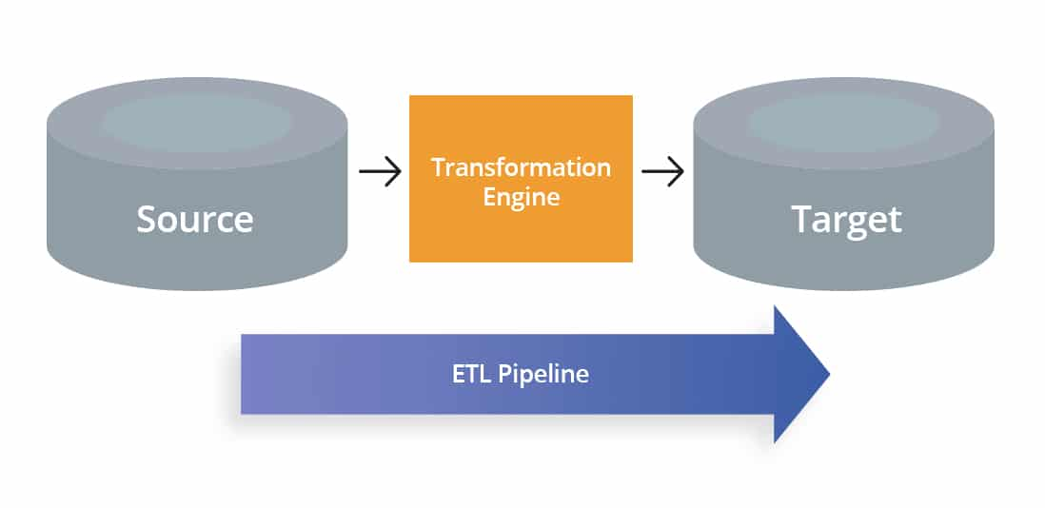
Spark - ETL
Load data
Transform
Aggregate
Save
From: https://www.astera.com/type/blog/etl-pipeline-vs-data-pipeline/
Notes:
Load can usually be parallelize because it is independent from each other.
Once the data is aggregated, i can be possible to write in parallel as well.
Even some transformation could be done in parallel as well !
You could represent all those transformation as a graph and all the independent branch up to the point they meet can be done at the same time

Slide 13
Spark - ETL
DB1
DB2
(B,C) => E
A => B
C => D
BD3
BD4
Notes:
Read, transformation, Write could be done at the same

Slide 14
Future

Slide 15
Future - the revelation - Spark Summit 2019
Parallelizing with Apache Spark in Unexpected Ways
from Anna Holschuh
Notes:
Works at Target
We will share the slides and you could click on those links to watch her full presentation, it was really inspiring to me.

Slide 16
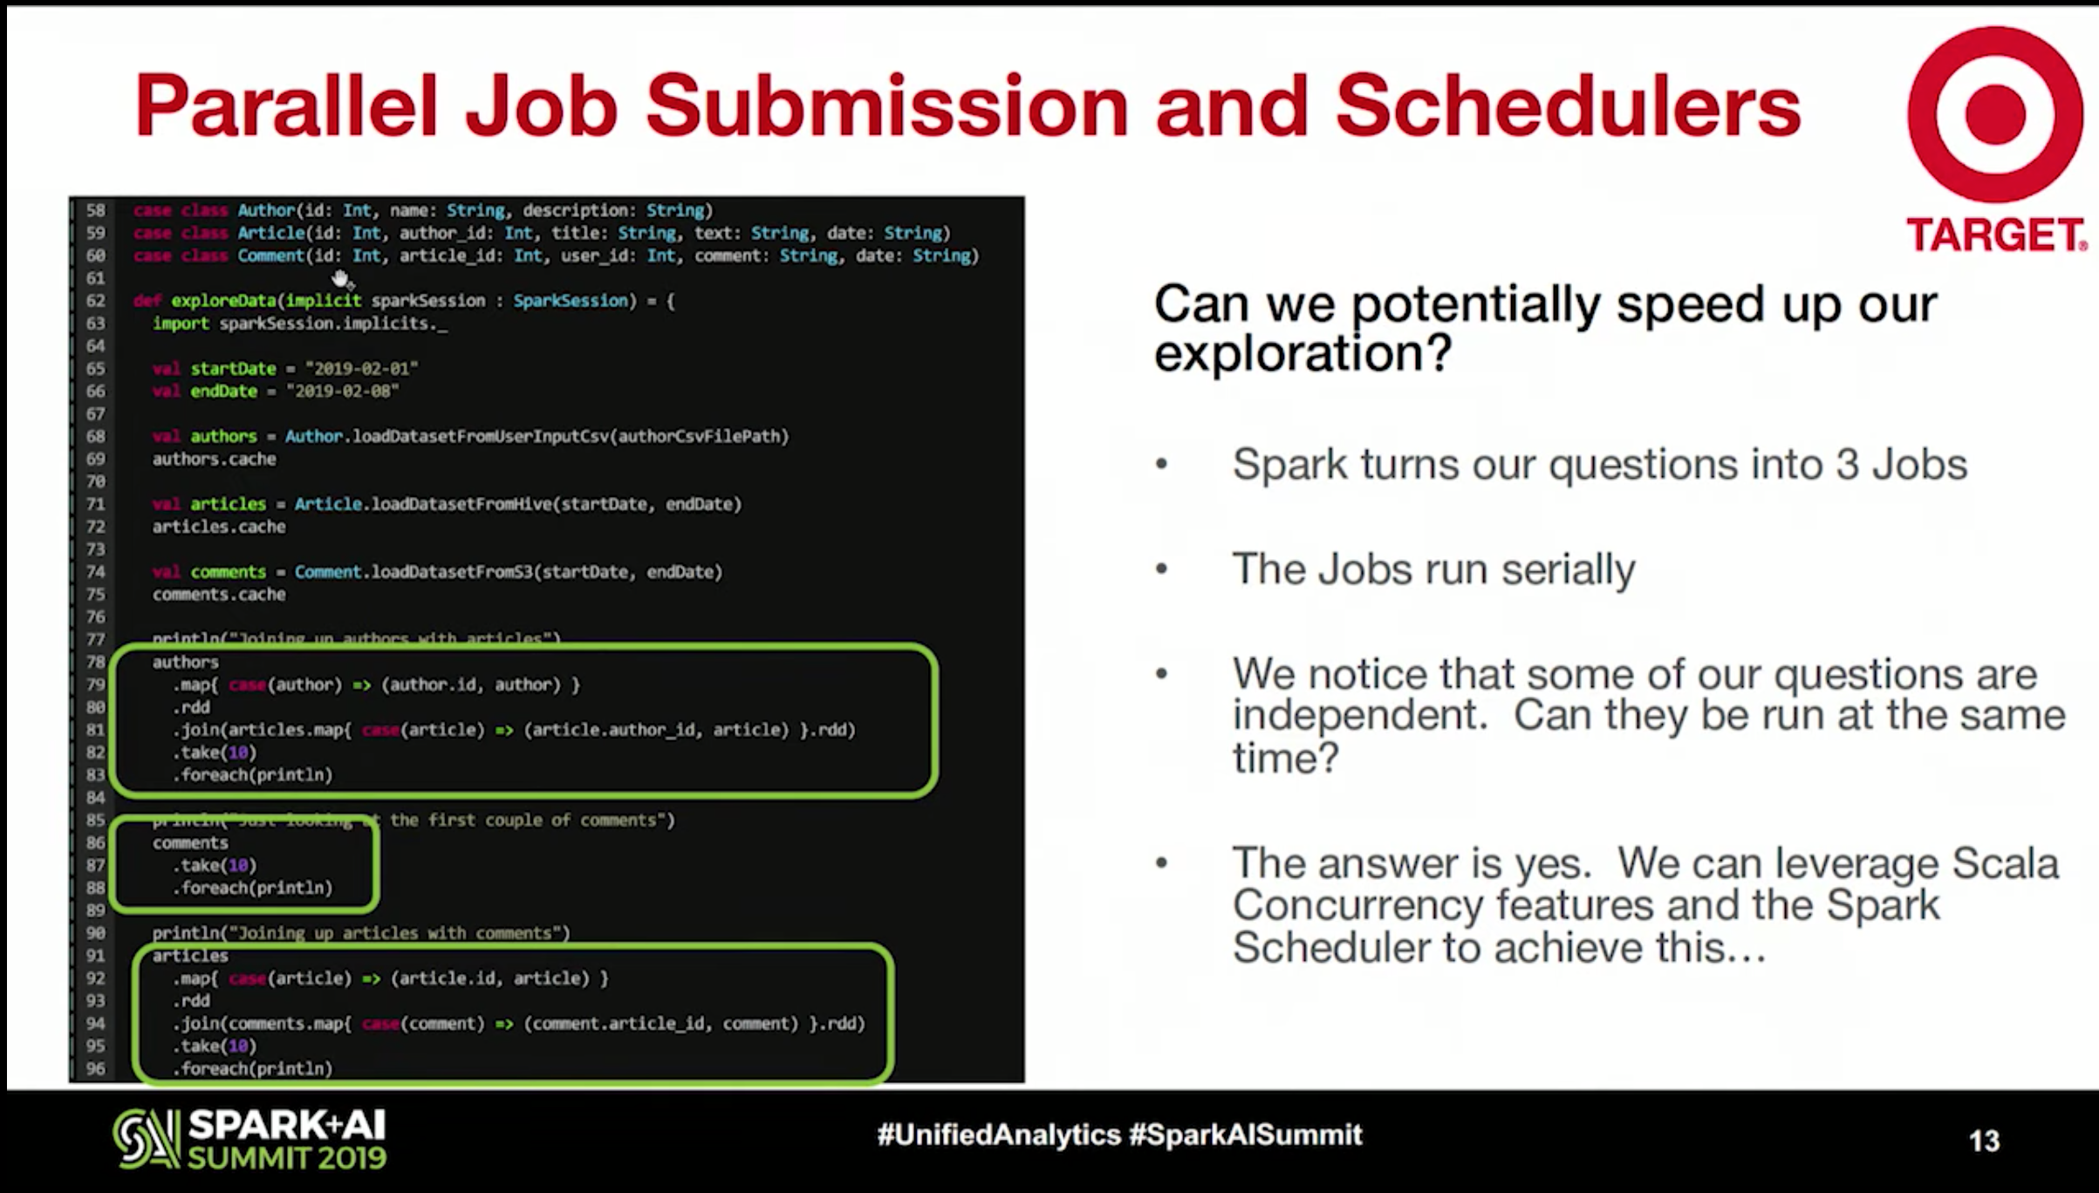
Fetching sources one at a time is not efficient
Notes:
Screenshot of her slides from Spark Summit 2019

Slide 17
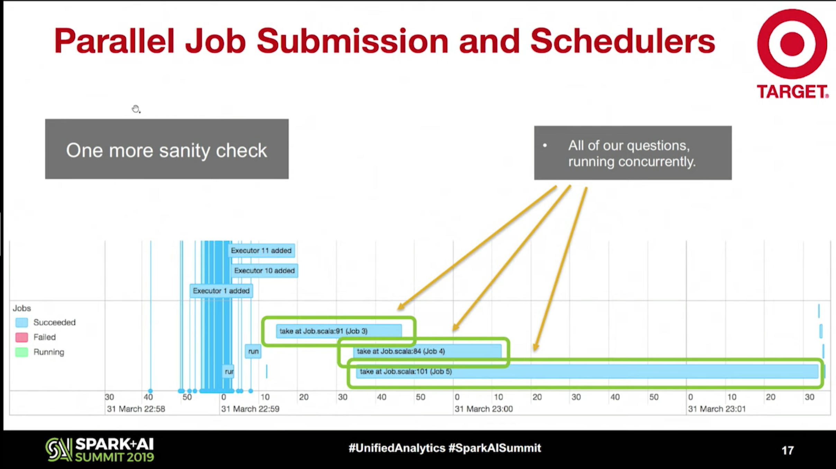
Fetching everything at the same time

Slide 18

Tried on production project at Demandbase
Raw
40min
Future
20min
Notes:
But there are still a lot of issues with Future
You cannot cancel them, so if you have an Await, to time box the step,
you might end up with Database writes, that happens in the background without you knowing
Or, if you want to implement a retry, since Future are starting immediately, it is not easy.

Slide 19
ZIO

Slide 20

ZIO
https://zio.dev/
Wrap sync and async operations smoothly
Can use map across anything at a macro level
Fully lazy
Notes:
You can wrap everything in ZIO, sync, async, spark operation, help functions, everything.
Nothing happen until you materialize the whole application

Slide 21
ZIO component
ZIO[R, E, A]
Environment: Requirements to execute this Task
Error
Output
Notes:
From anywhere you can access your configuration, no need to pass it from method to method over and over again

Slide 22
Nobody likes Future
Everything is wrapped in ZIO ( sync and async )
Async with Fibers, just call .fork
Cancellable !
Easy retries !
Easy timeout !
Simpler methods with less arguments because of Environment
Notes:
Imagine all you would get if you were to use this in a spark application
But it can be tricky to instantiate spark within ZIO infrastructure, because everything is lazy.
You do not want to recreate a spark context everytime you need it for instance

Slide 23



I have heard, people like memes
Notes:
Little meme interlude before talking about ZparkIO
The rest of the slides will be mostly code snippets so I am giving you all the meme earlier so you can remember it during the rest of the presentation

Slide 24
ZparkIO
Notes:
Introducing Z-park-I-O

Slide 25

Where to find it?
https://github.com/leobenkel/ZparkIO
Notes:
My dad made the animation ! Thanks to him :)
Merci papa, je taime!
I have to say it french for when he will rewatch it the replay.

Slide 26

Where to find it?
https://github.com/leobenkel/ZparkIO
Notes:
My dad made the animation ! Thanks to him :)
Merci papa, je taime!
I have to say it french for when he will rewatch it the replay.

Slide 27
What is it?
Boilerplate to start with ZIO and Spark
Lots of helper functions to make the code looks smoother
Easier to read the code
Easier to implement retries
Easier to implement timeout
Easier to parallelize tasks
Notes:
So what is ZparkIO and why would you want to use it in your project ?
I am trying to hide all the `import spark.implicits._` , not easy
You can wrap you spark.read in a ZparkIO element and implement a retry policy using ZIO
Or a timeout, if you want to give up on this source after n minutes
And you can call `fork` on the step that can be done at the same time
Whenever you need the result, just call `join`

Slide 28
Example use cases
https://github.com/leobenkel/ZparkIO/tree/master/ProjectExample/src/main/scala/com/leobenkel/zparkioProjectExample
https://github.com/leobenkel/ZparkIO/tree/master/ProjectExample_MoreComplex/src/main/scala/com/leobenkel/zparkioProfileExampleMoreComplex
Notes:
Links to the example project
Going to illustrate with the example projects in the repo
All the following slides , the code snippets come from those projects so you can read / run them yourself afterwards
Also, dont hesitate to ask questions and you can send me messages on linkedin too

Slide 29
How to use?
object Main extends Application {}
Notes:
If you Start with this.
Having all the code of your application in a Trait,
Which allow you to do that

Slide 30
Unit test the entire application
class ApplicationTest extends FreeSpec with TestWithSpark {
"Full application" - {
"Run" in {
TestApp.unsafeRunSync(TestApp.run("--spark-foo" :: "abc" :: Nil)) match {
case Success(value) =>
println(s"Read: $value")
assertResult(0)(value)
case Failure(cause) => fail(cause.prettyPrint)
}
}
}
}
object TestApp extends Application {}
Notes:
You can test the entire app as a unit test
No need to spin up a cluster
You can override all the environment if you have database of course.

Slide 31
Application
trait Application extends ZparkioApp[Arguments, RuntimeEnv, String] {
override def runApp(): ZIO[RuntimeEnv, Throwable, String] = {
for {
...
} yield { output }
}
override def makeEnvironment(
cliService: Arguments,
sparkService: SparkModule.Service
): RuntimeEnv = {
RuntimeEnv(cliService, sparkService)
}
override def makeSparkBuilder: SparkModule.Builder[Arguments] = SparkBuilder
override def makeCliBuilder: CommandLineArguments.Builder[Arguments] =
new CommandLineArguments.Builder[Arguments] {
override protected def createCli(args: List[String]): Arguments = {
Arguments(args)
}
}
}
Notes:
This is how to implement the App
Few things to make

Slide 32
Application
trait Application extends ZparkioApp[Arguments, RuntimeEnv, String] {
override def runApp(): ZIO[RuntimeEnv, Throwable, String] = {
for {
...
} yield { output }
}
override def makeEnvironment(
cliService: Arguments,
sparkService: SparkModule.Service
): RuntimeEnv = {
RuntimeEnv(cliService, sparkService)
}
override def makeSparkBuilder: SparkModule.Builder[Arguments] = SparkBuilder
override def makeCliBuilder: CommandLineArguments.Builder[Arguments] =
new CommandLineArguments.Builder[Arguments] {
override protected def createCli(args: List[String]): Arguments = {
Arguments(args)
}
}
}
Notes:
The configuration

Slide 33
Application
trait Application extends ZparkioApp[Arguments, RuntimeEnv, String] {
override def runApp(): ZIO[RuntimeEnv, Throwable, String] = {
for {
...
} yield { output }
}
override def makeEnvironment(
cliService: Arguments,
sparkService: SparkModule.Service
): RuntimeEnv = {
RuntimeEnv(cliService, sparkService)
}
override def makeSparkBuilder: SparkModule.Builder[Arguments] = SparkBuilder
override def makeCliBuilder: CommandLineArguments.Builder[Arguments] =
new CommandLineArguments.Builder[Arguments] {
override protected def createCli(args: List[String]): Arguments = {
Arguments(args)
}
}
}
Notes:
Spark session

Slide 34
Application
trait Application extends ZparkioApp[Arguments, RuntimeEnv, String] {
override def runApp(): ZIO[RuntimeEnv, Throwable, String] = {
for {
...
} yield { output }
}
override def makeEnvironment(
cliService: Arguments,
sparkService: SparkModule.Service
): RuntimeEnv = {
RuntimeEnv(cliService, sparkService)
}
override def makeSparkBuilder: SparkModule.Builder[Arguments] = SparkBuilder
override def makeCliBuilder: CommandLineArguments.Builder[Arguments] =
new CommandLineArguments.Builder[Arguments] {
override protected def createCli(args: List[String]): Arguments = {
Arguments(args)
}
}
}
Notes:
The environment

Slide 35
Application
trait Application extends ZparkioApp[Arguments, RuntimeEnv, String] {
override def runApp(): ZIO[RuntimeEnv, Throwable, String] = {
for {
...
} yield { output }
}
override def makeEnvironment(
cliService: Arguments,
sparkService: SparkModule.Service
): RuntimeEnv = {
RuntimeEnv(cliService, sparkService)
}
override def makeSparkBuilder: SparkModule.Builder[Arguments] = SparkBuilder
override def makeCliBuilder: CommandLineArguments.Builder[Arguments] =
new CommandLineArguments.Builder[Arguments] {
override protected def createCli(args: List[String]): Arguments = {
Arguments(args)
}
}
}
Notes:
And implement your app
That's it

Slide 36
ZparkioApp
ZparkioApp[C <: CommandLineArguments.Service, ENV <: ZparkioApp.ZPEnv[C], OUTPUT]
Command line input class
Environment for the zio.Runtime
Output of the run function
Notes:
Command line for input configuration.
The environment that needs to be provided
The output might usually be Unit, unless you are using this to be called by some other program as a library maybe.

Slide 37
RuntimeEnv
case class RuntimeEnv(
cliService: Arguments,
sparkService: SparkModule.Service
) extends System.Live
with Console.Live
with Clock.Live
with Random.Live
with Blocking.Live
with CommandLineArguments[Arguments]
with Logger
with FileIO.Live
with SparkModule {
lazy final override val cli: Arguments = cliService
lazy final override val spark: SparkModule.Service = sparkService
lazy final override val log: Logger.Service = new Log()
}
Notes:
Simple runtime, just have to assemble things

Slide 38
RuntimeEnv
case class RuntimeEnv(
cliService: Arguments,
sparkService: SparkModule.Service
) extends System.Live
with Console.Live
with Clock.Live
with Random.Live
with Blocking.Live
with CommandLineArguments[Arguments]
with Logger
with FileIO.Live
with SparkModule {
lazy final override val cli: Arguments = cliService
lazy final override val spark: SparkModule.Service = sparkService
lazy final override val log: Logger.Service = new Log()
}
Notes:
This is provided by ZIO already

Slide 39
RuntimeEnv
case class RuntimeEnv(
cliService: Arguments,
sparkService: SparkModule.Service
) extends System.Live
with Console.Live
with Clock.Live
with Random.Live
with Blocking.Live
with CommandLineArguments[Arguments]
with Logger
with FileIO.Live
with SparkModule {
lazy final override val cli: Arguments = cliService
lazy final override val spark: SparkModule.Service = sparkService
lazy final override val log: Logger.Service = new Log()
}
Notes:
This is the configuration

Slide 40
RuntimeEnv
case class RuntimeEnv(
cliService: Arguments,
sparkService: SparkModule.Service
) extends System.Live
with Console.Live
with Clock.Live
with Random.Live
with Blocking.Live
with CommandLineArguments[Arguments]
with Logger
with FileIO.Live
with SparkModule {
lazy final override val cli: Arguments = cliService
lazy final override val spark: SparkModule.Service = sparkService
lazy final override val log: Logger.Service = new Log()
}
Notes:
The logger

Slide 41
RuntimeEnv
case class RuntimeEnv(
cliService: Arguments,
sparkService: SparkModule.Service
) extends System.Live
with Console.Live
with Clock.Live
with Random.Live
with Blocking.Live
with CommandLineArguments[Arguments]
with Logger
with FileIO.Live
with SparkModule {
lazy final override val cli: Arguments = cliService
lazy final override val spark: SparkModule.Service = sparkService
lazy final override val log: Logger.Service = new Log()
}
Notes:
And spark
So there is a little bit of work but everything is strongly type so the compiler should guide you in the correct direction

Slide 42
Configurations

Slide 43
Configurations
case class Arguments(input: List[String])
extends ScallopConf(input) with CommandLineArguments.Service {
val inputId: ScallopOption[Int] = opt[Int](
default = Some(10),
required = false,
noshort = true
)
}
object Arguments {
def apply[A](f: Arguments => A): ZIO[CommandLineArguments[Arguments], Throwable, A] = {
CommandLineArguments.get[Arguments](f)
}
}
Notes:
Just want to point out that the underlying library for command line arguments is Scallop
If you have used Scallop before, you know you have to call `verify` but ZparkIO is doing for you , so no need here.
The last method in the companion object, allow you to do that:

Slide 44
Using Configurations
for {
...
a <- Arguments(_.inputId())
...
} yield { ??? }
No need to pass Arguments to all your methods.
Always accessible through the ZIO environment
Notes:
From anywhere you can access your configuration, no need to pass it from method to method over and over again

Slide 45
ZIO(spark)
Notes:
What about Spark ?

Slide 46
Building Spark
object SparkBuilder extends SparkModule.Builder[Arguments] {
override protected final lazy val appName: String = "Zparkio_test"
override protected def updateConfig(
sparkBuilder: SparkSession.Builder,
arguments: Arguments
): SparkSession.Builder = {
sparkBuilder.config("spark.foo.bar", arguments.sparkFoo())
}
}
Notes:
If you want to override configurations using command line,
this method has a default implementation
and there are more method you can override to customize your spark session

Slide 47
Fetching SparkSession
for {
...
spark <- SparkModule()
...
} yield { ??? }
No need to pass SparkSession to all your methods.
Always accessible through the ZIO environment
Notes:
Spark always available in case you need it, through the environment, no need for implicit or to pass it as argument everywhere.
But let's see how you might never need to do that anyway.

Slide 48
Helper functions
Notes:
ZparkIO provide a lot of helper functions to help streamline your project and write your code faster. Let's see a few.

Slide 49
Making Datasets
for {
...
outputs <- ZDS { spark =>
import spark.implicits._
inputDS.map(_.toOutput)
}
...
} yield { ??? }
Lots of helper functions
Notes:
How to transform a Dataset[A] to Dataset[B] with the implicit imported.
No need to first fetch spark and then make a Task for it.

Slide 50
Making Datasets
for {
...
outputs: Dataset[CaseClass] <- ZDS(
CaseClass(a = 1, b = "one"),
CaseClass(a = 2, b = "two"),
CaseClass(a = 3, b = "three")
)
...
} yield { ??? }
Helpful in test
Turn a Seq to a Dataset .
Notes:
Create a Dataset directly from a List of items
No need to import implicits, it is done internally

Slide 51
Transforming Datasets
for {
...
outputs: Dataset[OutputCaseClass] <- ZDS(
CaseClass(a = 1, b = "one")
).zMap {
case TestClass(a, b) => Task(OutputCaseClass(a + b.length))
}
...
} yield { ??? }
No need to do _.map(_.map(???)) anymore
Notes:
Transform a Dataset[A] to Dataset[B]
If you want to return a ZIO object to transform a dataset

Slide 52
Broadcasting
for {
...
authorIds: Broadcast[Array[Int]] <- ZDS.broadcast { spark =>
import spark.implicits._
posts.map(_.authorId).distinct.collect
}
...
} yield { ??? }
Broadcast easily
Notes:
Broadcast is provided as well
The implicit could be already included but was complicated to support all types. Feel free to open a PR !

Slide 53
From Futures
Notes:
If you start from an existing project, those will be useful to start

Slide 54
From Future
import com.leobenkel.zparkio.ZFuture._
val z = (Future(???)(_)).toZIO
https://github.com/leobenkel/ZparkIO/blob/master/Library/src/main/scala/com/leobenkel/zparkio/ZFuture.scala
Notes:
You can wrap your method in Future so start converting your application from top to bottom

Slide 55
In production
Notes:
Let's see the results in the same production we talked about earlier

Slide 56
Tried on production project at Demandbase
Future
3h
ZIO
2h
Faster
Less errors because of easy retry
Cheaper because of timeout limit
Better error logs because of Fiber logs
Notes:
This is about the same project I talked about earlier but a lot of new features have been added in the last year so it now takes around 3 hours. Pipeline tends to grow over time.
This project in the last year had grown a lot, so i now takes 3 hours ( instead of the previous 20 min we saw in the beginning )
But with ZparkIO, it now takes 2h
And tons of side advantages !
Able to retry
Timeout
The code is easier to read and maintain
Better unit test

Slide 57
Fetching everything at the same time
Notes:
Do you remember the slides from earlier with the Future presentation ?
Let's see what it looks like with our project and ZparkIO
Noticed that we have 3 consecutive tasks here, right ?

Slide 58
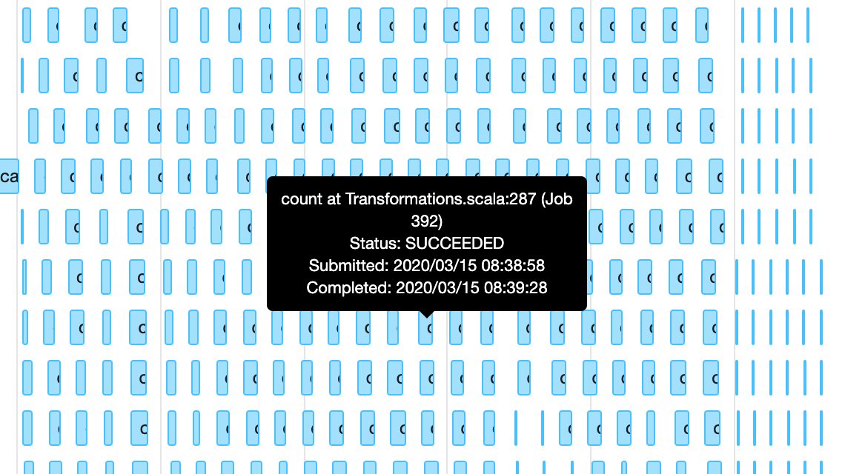
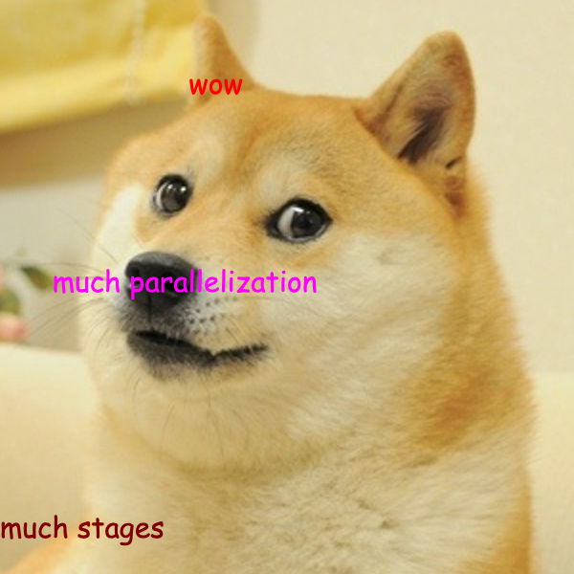
Fetching everything at the same time
Notes:
Here you go !

Slide 59
What next?

Slide 60
What next?
https://github.com/leobenkel/ZparkIO/issues
Giter8 to make starting a project easier
Build for all Spark versions

Slide 61
Questions?

